Slide 1
Transfer Runs

Slide 2
Work Flow Options
Creating the Transfer as two paired orders.
In this option the student has two transportation assignments, one that contains pickup to transfer point and then transfer point to drop off.
Creating a transfer as a single solve.
In this option time windows are set at the transfer point and the drop off school so that it allows the solver to solve the entire problem using a single vehicle. Stops are moved to the workspace and a single vehicle is used to solve the run.

Slide 3
The Transfer As Two Paired Orders
The student must have two distinct paired orders, one the goes from the home location to the transfer location and one that goes from the transfer location to the school of attendance. In the example below the student goes from the home address on Snow Trail to the transfer location at Staton elementary school, then goes from Staton Elementary to the school of attendance at Tarr Elementary.

Slide 4
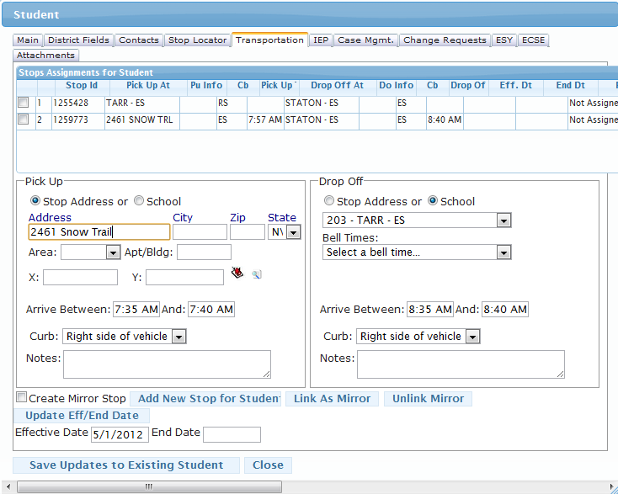
Creating The First Paired Order (student pickup to transfer)
Student Stop Address
Transfer Stop Location

Slide 5
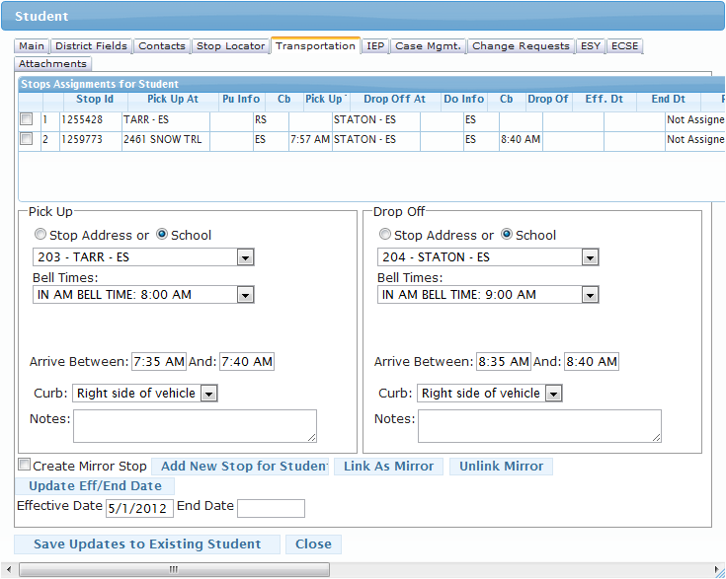
Creating a Transfer Stop
Creating a transfer stop is easy, in the example below we are creating a transfer stop at one school going to another. The transfer could be any other address or location as well, just select stop address instead of School.
The Transfer Location
The School Of Attendance

Slide 6
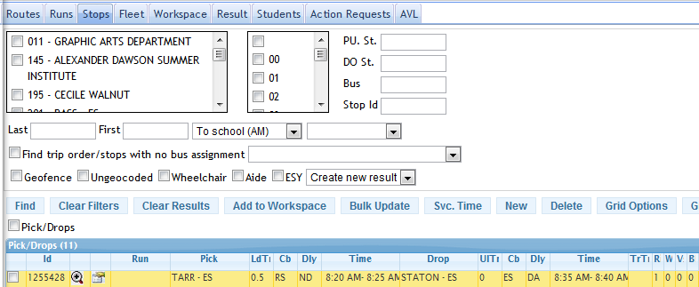
Create An Order From The Transfer Point To The School
From The Stops Tab

Slide 7
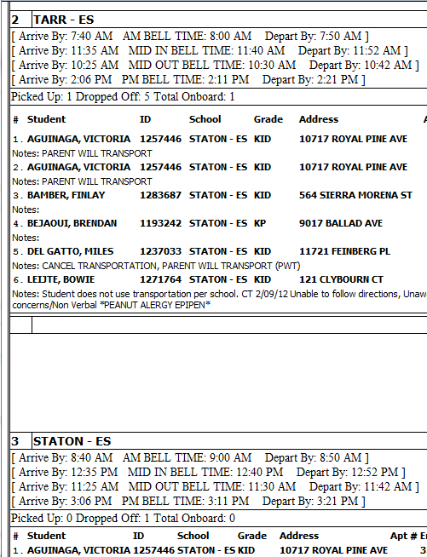
Driver Directions
Note Dropped off and Picked up Numbers
Student Drop off at Transfer Point
Student Pick up at Transfer Point
Student drop off at attending school

Slide 8
The Transfer As A Single Solve
The Student Screen

Slide 9
Create School Bell Times For Transfer Point

Slide 10
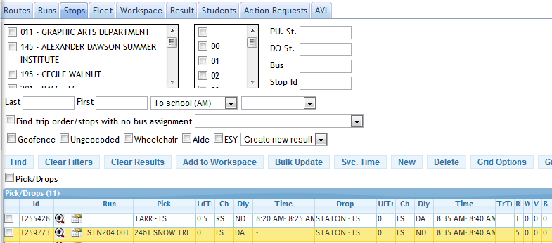
Create An Order To The Student School Of Attendance
From The Stops Tab

Slide 11
The Workspace

