Slide 1
Publishing Maps for Compass

Slide 2
Overview
GIS Publishing Maps for Compass
ArcCatalog: Map Documents and Services
Share as a Service
Select a Service to Overwrite
Check Compass Route Builder

Slide 3
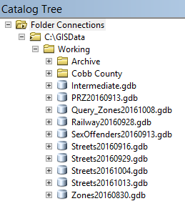
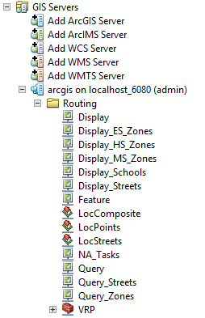
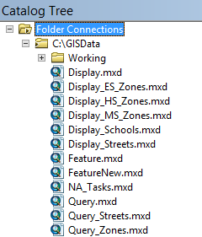
ArcCatalog: Map Documents and Services
1. Spatial Data
3. Services
2. Map Documents
Spatial data is stored under the Working folder, and Map Documents (MXDs) are created using these data.
MXDs are created in the GISData folder and published to the Server as Services.
Services are published with the same name as MXDs.

Slide 4
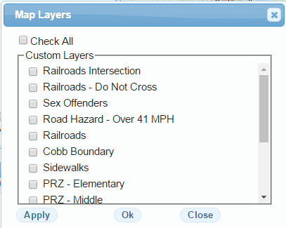
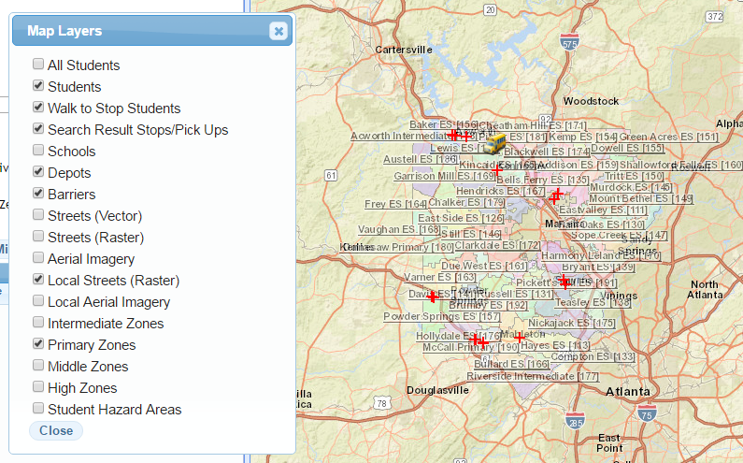
ArcCatalog: Map Documents and Services
Services
Route Builder
Services are published for Compass to use:
Display services are shown in Custom Lyrs.
Display_[Description] are shown in Layers.
Query_Streets are used for Directions
Tip: You can change the name, label, and symbology of the layers in the MXDs.
Changes made in the MXDs will reflect in Compass after publishing.

Slide 5
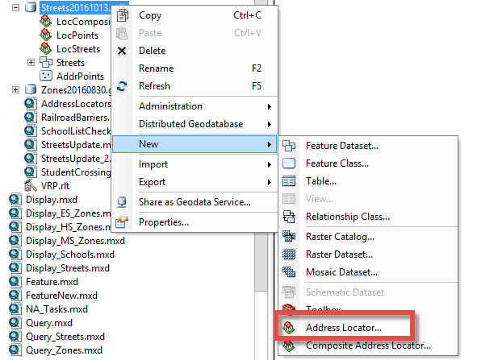
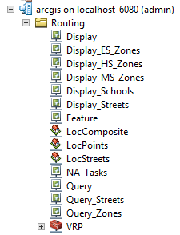
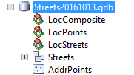
ArcCatalog: Map Documents and Services
Services
Route Builder
LocStreets are created and published from the Streets GDB.
Address Locators are used for finding an address or geocoding students, stops, and schools.
To create/update an Address Locator, right-click on the Streets GDB -> New -> Address Locator.
For Cobb, the Address Locator (LocStreets, LocPoints) is derived from the Streets and AddrPoints layer respectively.
LocComposite uses LocPoints and LocStreets together for finding more accurate matches.
For help on creating an address locator, refer to: http://desktop.arcgis.com/en/arcmap/10.3/guide-books/geocoding/creating-an-address-locator.htm

Slide 6
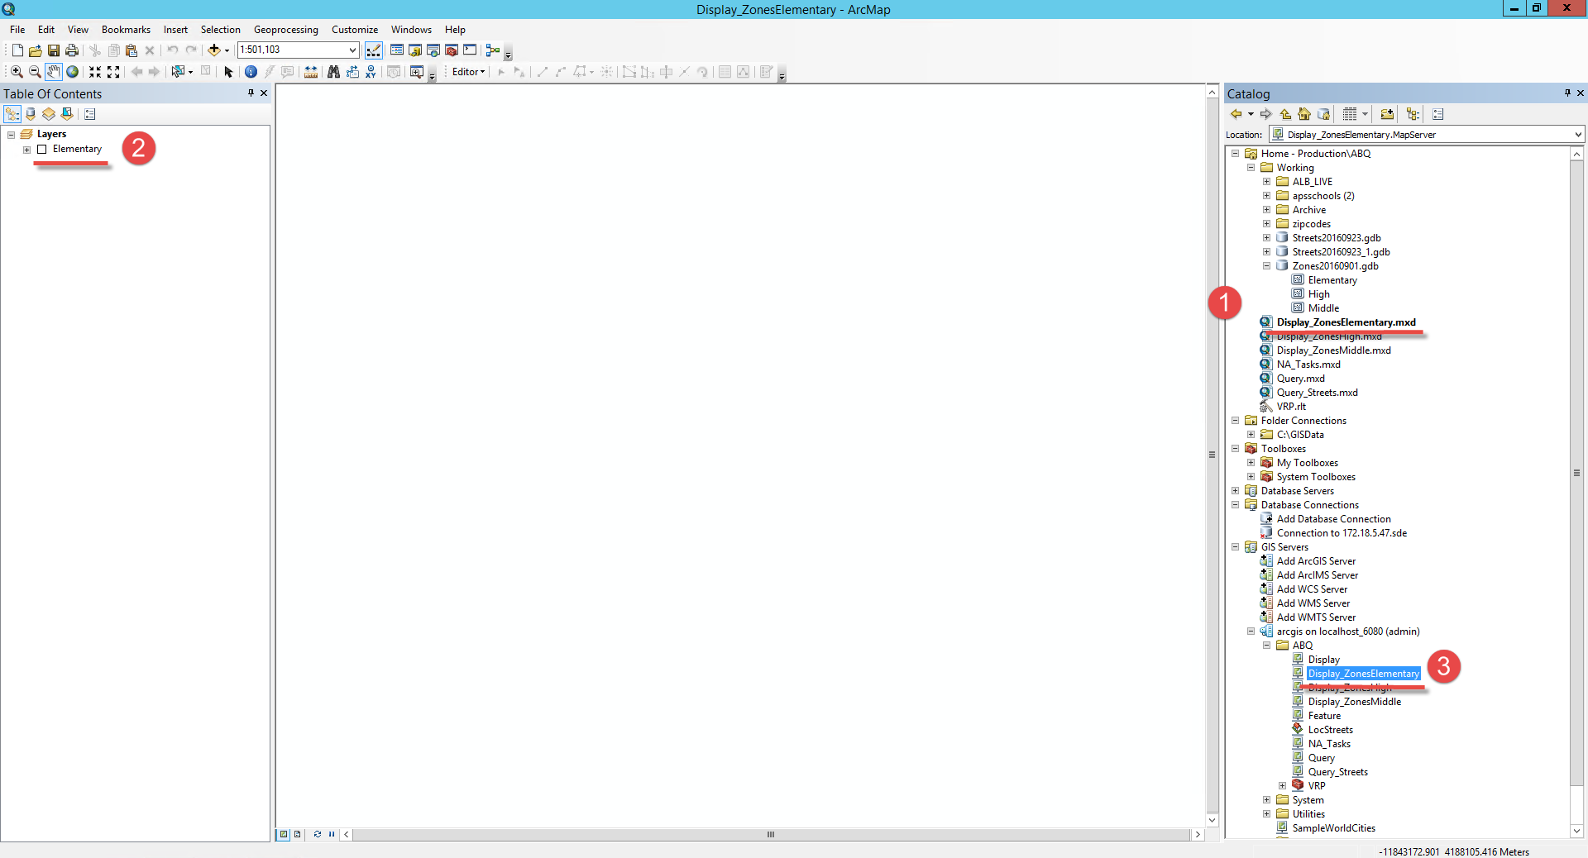
ArcCatalog: Map Documents and Services
Open up a Map Document (MXD) from Production folder (ex. Display_ZonesElementary)
Leave the Layers unchecked
The MXD will overwrite as a service in the server with the same name
Tip: If you are working with ArcMap 10.4, make sure to save the MXD for version 10.2 using Save a Copy command so it can be opened in the Server!

Slide 7
Share as a Service
Go to File > Share As > Server…

Slide 8
Share as a Service
Select Overwrite an existing service

Slide 9
Share as a Service
Select Overwrite an existing service and click Next >

Slide 10
Share as a Service
Select a Service to overwrite and select Continue

Slide 11
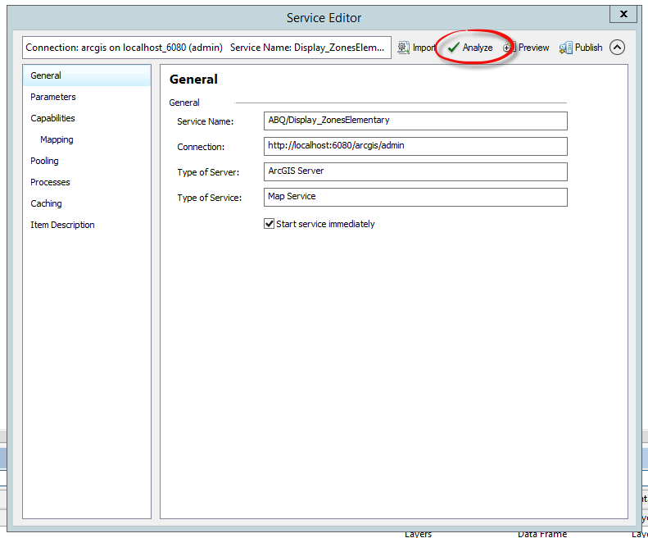
Share as a Service

Slide 12
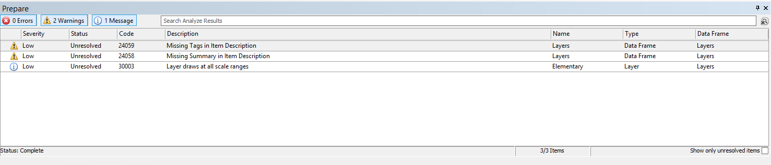
Share as a Service

Slide 13
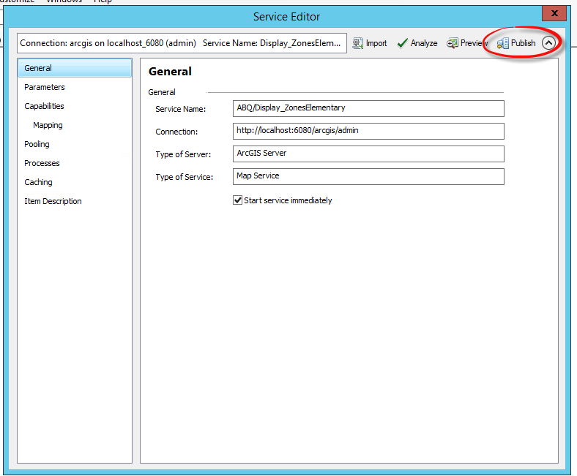
Share as a Service

Slide 14
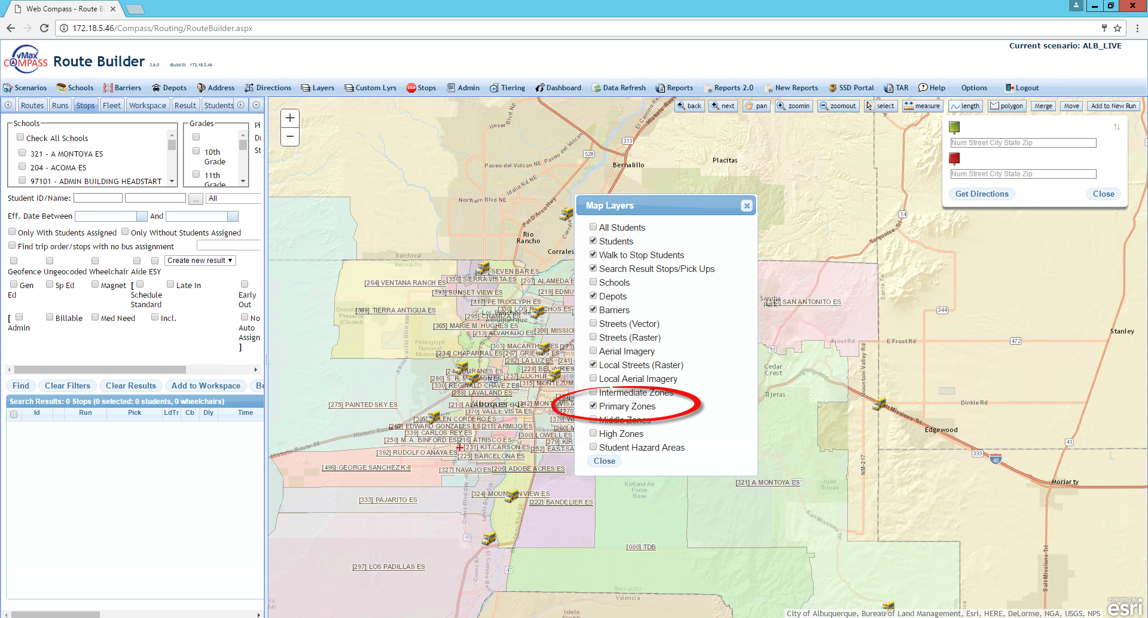
Share as a Service

