Slide 1
How to Create a Tiering Plan

Slide 2
Step 1
Select the Tiering Option from the main Dashboard in Route Builder

Slide 3
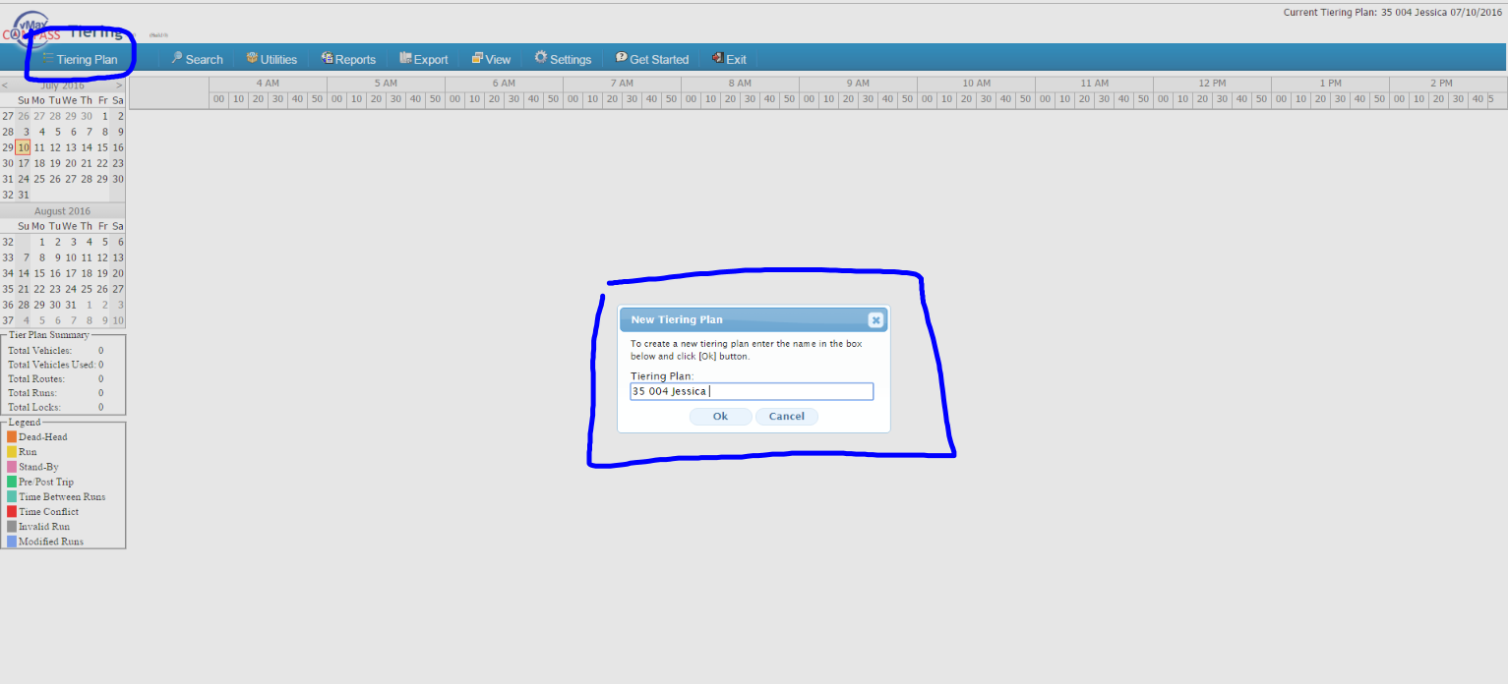
Step 2 Naming the Plan
Click on Tiering Plan
Name the Tiering plan (this is similar to creating a scenario in Route Builder)
Click Ok to save the name.

Slide 4
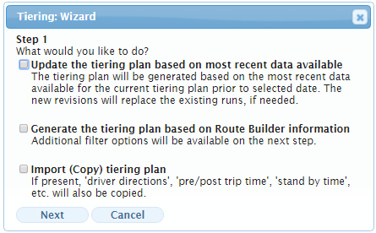
How to use the Tiering Wizard
1. Update the tiering plan based on the most recent data: this option will allow the user to generate routes based on the most recent Run data in Route builder.
2. Generate the tiering plan based on Route Builder information: Allows a user to add filters for specific data migration.
3. Import tiering plan: Data such as Route names, driver directions, pre/Post trip times and stand by time will import over from a previous tiering date.

Slide 5
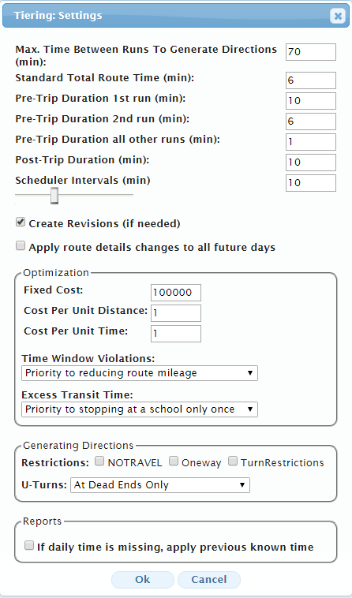
Establishing the Settings
Max time Between Runs: considered to be the time between the dead heads of 2 consecutive runs on the same route.
Standard Total Route Time: used when adding automatic stand by time on route if the bid time is not specified.
Pre-Trip: specify the designated pre-trip time a driver is required to perform before the trip/run.
Post-Trip: specify the designated post-trip time a driver is required to perform after the trip/run.

Slide 6
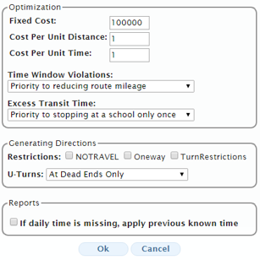
Settings Continued
1
1. Optimization is to optimize the Route plan. Route directions also have VRP settings similar to those in Route Builder.
2. Generating Route Directions are specified here. (U-turns and other travel restrictions.)
3. If daily time is missing, this selection will apply the previous known time for the run time. The report this affects is Weekly Reports.
2
3

Slide 7
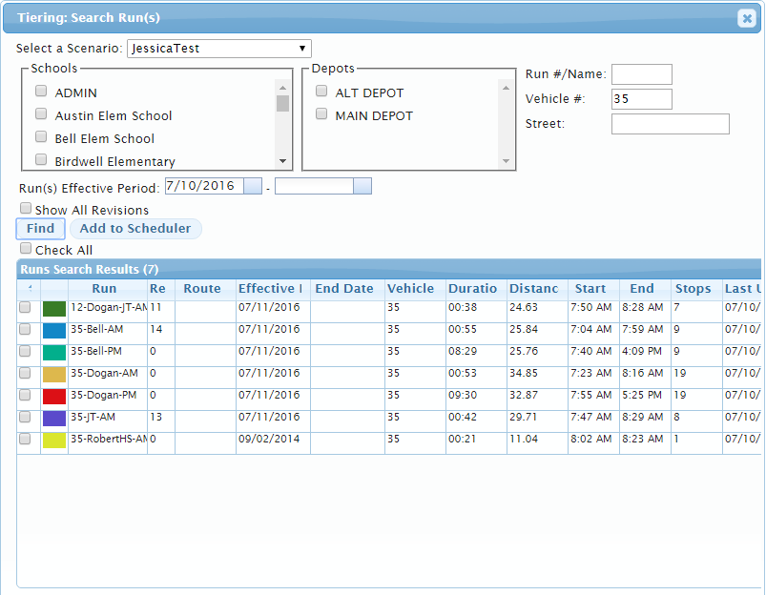
How to Populate the runs into the Plan
Select the scenario
Input the remaining filters to populate the desired runs.
Run #/Name
Vehicle
Street address
School
Depot
Place check mark next to runs and click “Add to scheduler”

Slide 8
Applying the Pre/Post trip and Generating the Route Directions
Step 1: Select the Utilities Menu and load the Pre/Post trips
Step 2: Generate the directions under the Utilities Menu
Before
After

Slide 9
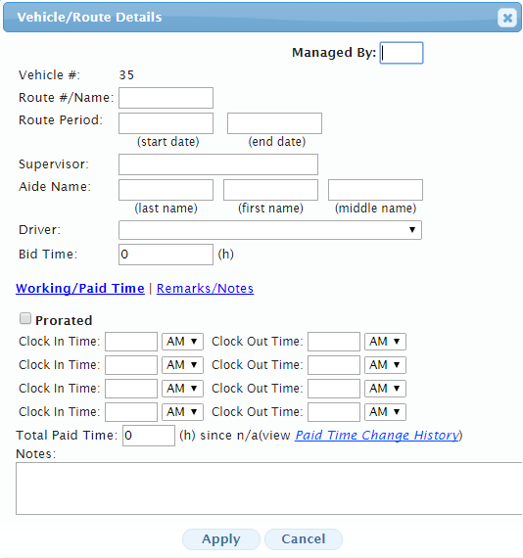
Once the data is loaded……
Name the Route, hoover above the route block and select “Edit Details”
Name the Route
Once the Route has been named, you are ready to save the Route.

Slide 10
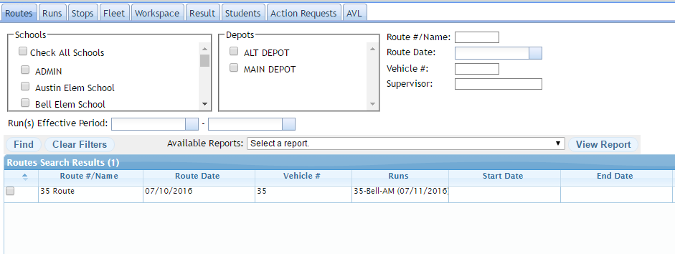
Generating Route Reports
Once the tiering plan has been saved, you can query for the Route in Route Builder.
You can now run all available route reports.

