Slide 1
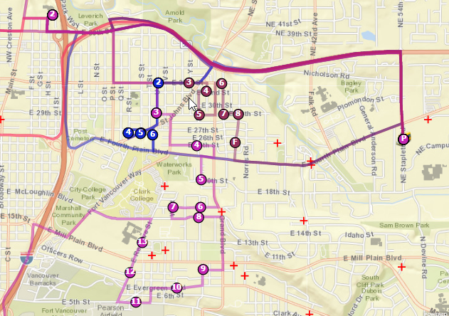
Compass Route Builder Overview

Slide 2
What is Compass Route Builder?
Compass Route Builder provides an interface for a transportation personnel to complete routing operations, daily student transportation needs and reporting functionality .
Tools in Compass:
Route optimization
Reports
Student Transportation information
Nightly Download

Slide 3
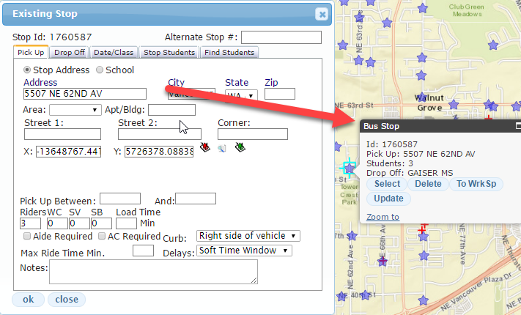
Stops

Slide 4
Types of Run solving in Compass
Simple Solve
Fleet Solve
Workspace
Click Through Routing
Drag and Drop

